Slide 1


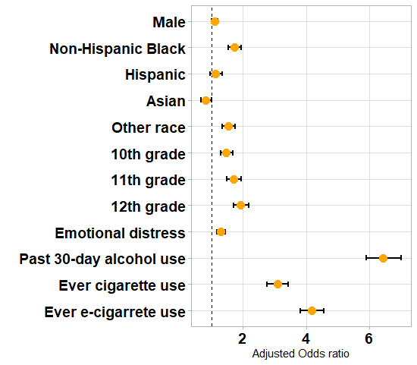
RESULTS
Any lifetime e-cigarette use was a strong and statistically significant predictor of past 30-day cannabis use.
Prevalence of past 30-day cannabis use:
38.3% (95% CI: 37.1% – 39.6%) among those reporting lifetime e-cigarette use
6.7% (95% CI: 6.3% – 7.1%) among those reporting no lifetime e-cigarette use
Lifetime Electronic Cigarette Use is Associated with Increased Risk of Current Cannabis Use among Maryland High School Students
Any lifetime
e-cigarette use
is associated with
4-fold increased odds
of current cannabis use among Maryland high school students
(aOR = 4.18; 95% CI: 3.83 – 4.57).
Johannes Thrul PhD, Amanda Luken BS,
Renee M. Johnson PhD, MPH
Department of Mental Health, Johns Hopkins Bloomberg School of Public Health, Baltimore, MD, USA
Odds of Current Cannabis Use among
MD High School Students in 2016
aOR (95% CI)
1.10 (1.00 - 1.20)
1.72 (1.53 - 1.94)
1.13 (0.96 - 1.33)
0.82 (0.67 - 1.00)
1.52 (1.33 - 1.74)
1.46 (1.28 - 1.67)
1.71 (1.49 - 1.95)
1.92 (1.70 - 2.18)
1.30 (1.17 - 1.44)
6.44 (5.91 - 7.02)
3.09 (2.77 - 3.44)
4.18 (3.83 - 4.57)
INTRODUCTION
Historically, cigarettes preceded cannabis initiation, but recently, youth cigarette use has been on the decline and e-cigarettes have been growing in popularity.
E-cigarettes are currently the most common mode of nicotine and tobacco consumption for youth.
E-cigarettes may increase the odds of future cannabis use among youth.
Objective: To investigate the association between lifetime e-cigarette use and past 30-day cannabis use among Maryland high school students.
Odds of past 30-day cannabis use were higher among:
Youth reporting past 30-day alcohol use, any lifetime cigarette use, and emotional distress
10th – 12th graders (vs. 9th )
Students in the Non-Hispanic Black and “Other” race groups (vs. White)
METHODS
Secondary analysis of the CDC’s 2016 Maryland Youth Risk Behavioral Survey/Youth Tobacco Survey (YRBS/YTS).
Two-stage cluster sample design (i.e., schools, classes within schools).
Data are representative of school-attending youth in the state (weighted n 201,357).
Statistical Analysis
Multivariable logistic regression to assess lifetime electronic cigarette use (exposure) in association with past 30-day cannabis use (outcome)
Adjusted for sex, grade, race/ethnicity, county, lifetime cigarette use, past 30-day alcohol use, and emotional distress.
Used R version 3.4.3 via the survey package.
DISCUSSION
Preliminary evidence that e-cigarette use may precede cannabis use among Maryland youth.
Preventing e-cigarette use could delay the initiation of cannabis use.
Data were cross-sectional. Longitudinal studies are needed to determine the temporality between e-cigarette and cannabis use among youth.
Acknowledgements: Data collection was supported by the Maryland Department of Health (MDH) and the Maryland State Department of Education (MSDE). The authors report no conflict of interest.

